Slide 1
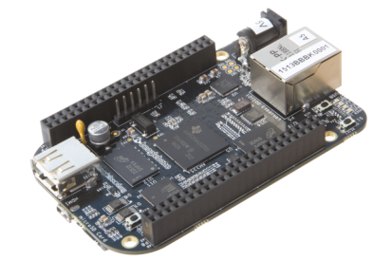
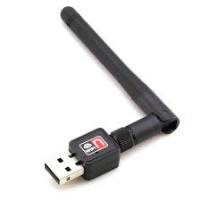
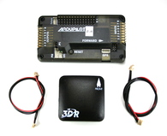
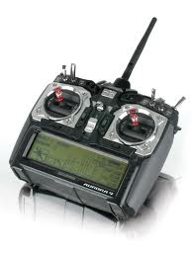
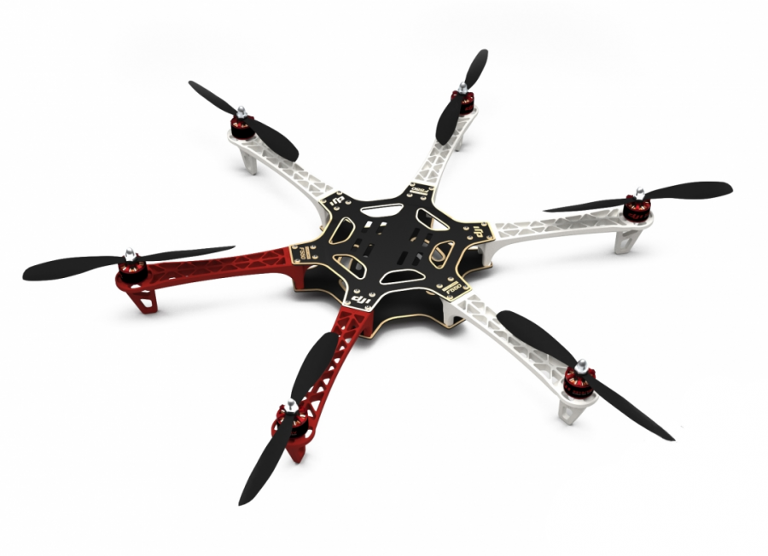
}
{
  WiFI
  BBBK
  CentMesh
  Mobile Node
MAVLink over
USB
Abort
Signal
  Autopilot
CentMesh
Drone
PWM
Commands
  Airframe

Slide 2

  CentMesh Mobile Node
MAVLink over
USB
  Autopilot
MCP over
UDP/IP
  CentMesh Drone

Slide 3
Sensor Node
MAVLink over
USB
Abort
Signal
Autopilot
PWM
Commands
Airframe

