Slide 1
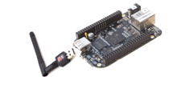
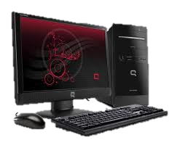

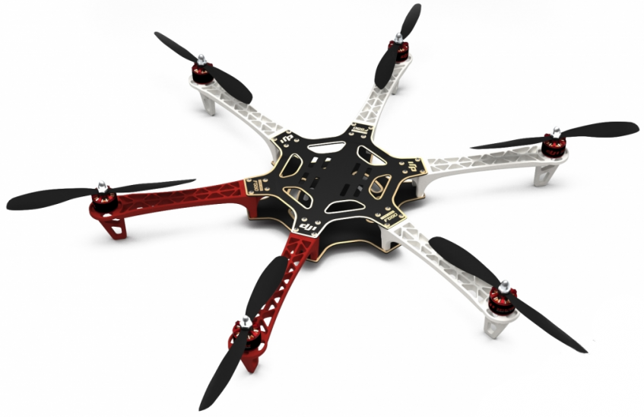
Fixed
Node
Controller
CentMesh
Gateway
Mobile
Node
CentMesh
Node
Internet

Slide 2
Internet
Driver
Sensor
Mgr
Client
Comm
Comm
Server
Comm
Controller
Driver

