Slide 1

CentMesh Drones Challenge 2014
Tutorial
Mihail L. Sichitiu, Rudra Dutta
Vaidyanathan Ananthanarayanan
Ramachandra Kasyap Marmavula
North Carolina State University

Slide 2
Outline
CentMesh Overview
CentMesh Drones Challenge Overview
Drone Hardware Architecture
Drone Software Architecture
SITL Introduction
Drone Programming 101
Drone Hardware Details

Slide 3
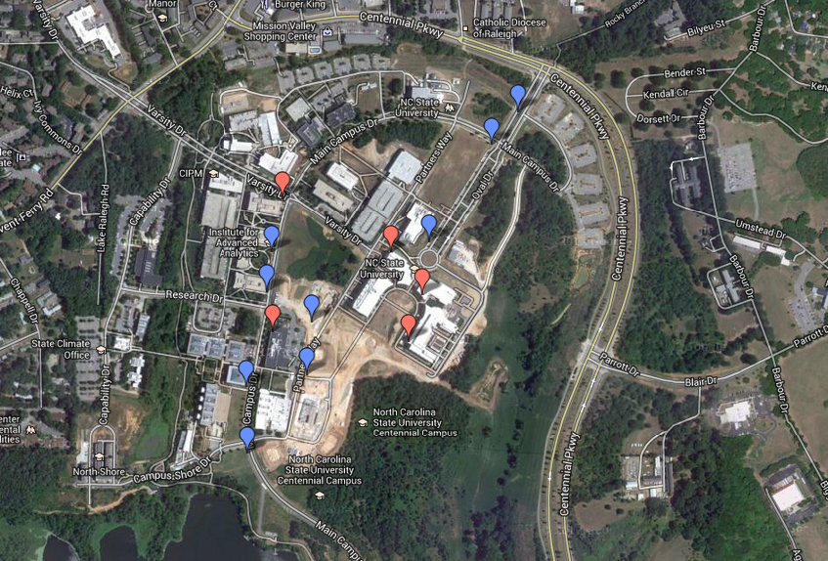
CentMesh – Centennial Wireless Mesh Network Testbed - Map

Slide 4
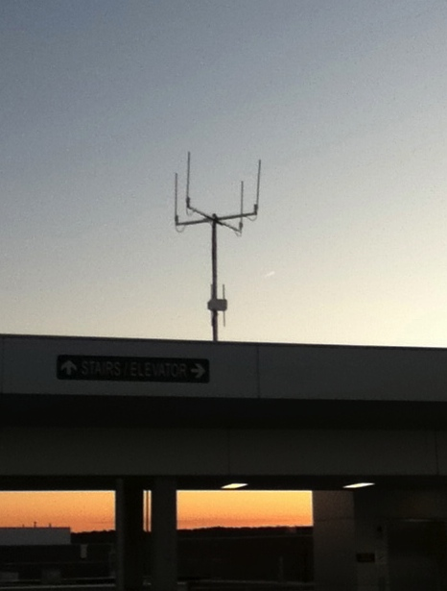

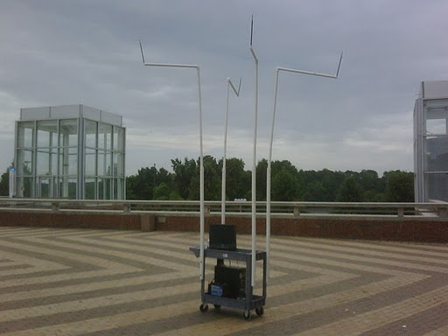
CentMesh Nodes
Fixed Routers
Mobile Routers

Slide 5
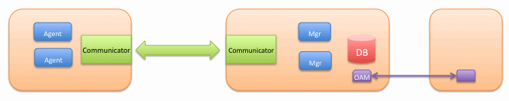
CentMesh - Software Architecture
P1
P2
P3
…
Communicator
Communicator
Communicator
Communicator
Communicator
P1
P2
P3
…
P1
P2
P3
…
P1
P2
P3
…
P1
P2
P3
…
machine
process

Slide 6
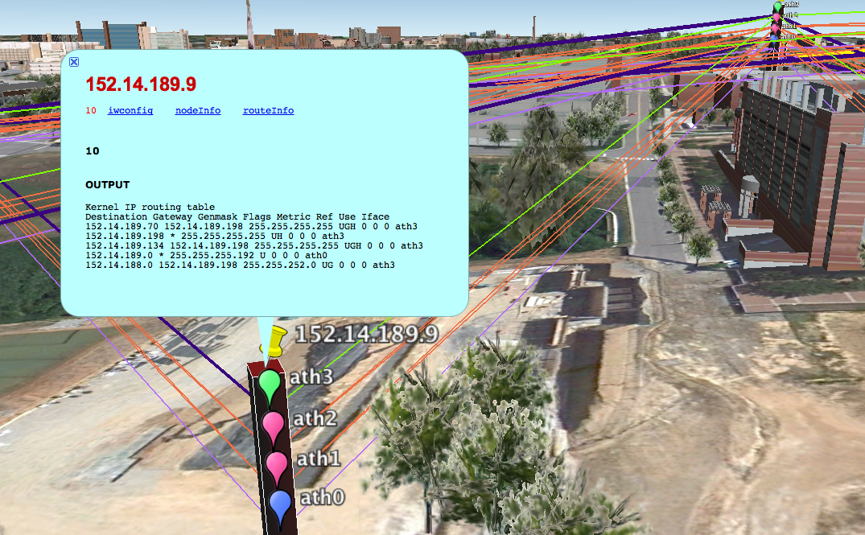
Operation and Management Software
Based on Google Earth/Maps

Slide 7


CentMesh
Mobile Distributed Sensing
What?
  Detect and track geographically distributed signal “sources”
How?
  Fixed Sensor Nodes
  Mobile Sensor Nodes
  Distributed Processing

Slide 8
Outline
CentMesh Overview
CentMesh Drones Challenge Overview
Drone Hardware Architecture
Drone Software Architecture
SITL Introduction
Drone Programming 101
Drone Hardware Details

Slide 9
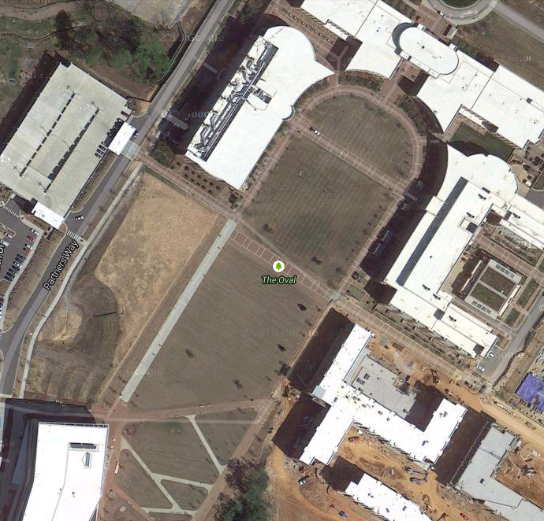
CentMesh Drones Challenge
Overview
Two objectives for the participants:
  To learn about drone technology in detail, and
  To have fun.
On the Oval

Slide 10
Three Step Process
5 Stepping stones
  Not checked by us
3 Qualifying challenges
  Required for qualification for the grand challenge
Grand challenge
  Possibly with a bonus challenge

Slide 11

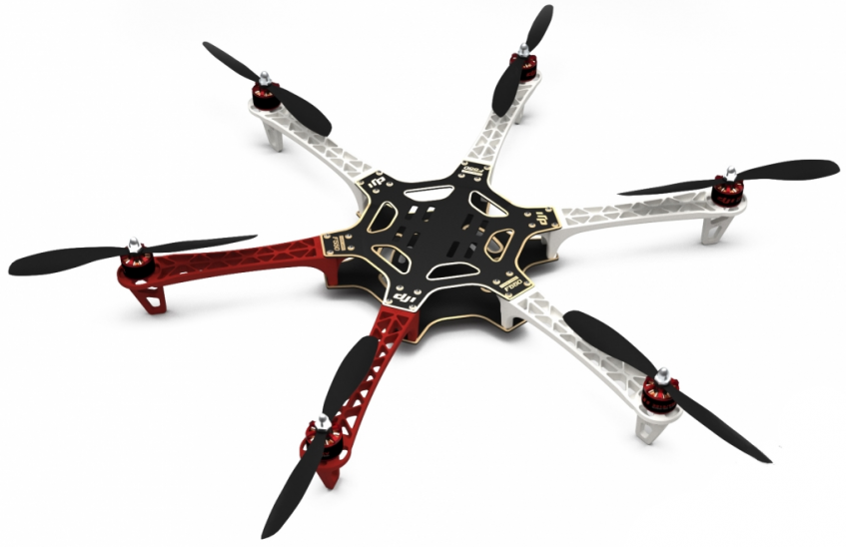
Stepping Stone 1
From a landed position, fly vertically up to an altitude of 10 meters, and stationkeep (LOITER) for 2 minutes. Then fly vertically down and land. Vertical speeds should not exceed 2 meters/second.

Slide 12
Stepping Stone 2
UDP Port X
From a landed position, fly vertically up to an altitude of 10 meters, and stationkeep. Your application should listen for a broadcast IP message to UDP port 7899 to return. Once the message is received, fly vertically down and land. Vertical speeds should not exceed 2 meters/second.

Slide 13
Stepping Stone 3
UDP Port X
From a landed position, fly vertically up to an altitude of 10 meters, and stationkeep. Your application should listen for a broadcast IP message to UDP port 7899 – the message (in format to be pre-specified) will contain a sequence of coordinates, which you should fly to in order, holding position for 5 seconds at each. You must fly only vertically or horizontally at any given time. Once at the last coordinate, return to initial stationkeeping position, then land vertically

Slide 14
Stepping Stone 4
Same as previous, but you must avoid pre-designated volumes of space during flight – these volumes will be in the shape of rectangular blocks.
UDP Port X

Slide 15
Stepping Stone 5
Same as previous, but once every second you must sense the ambient temperature and submit the reading to the CentMesh sensing service.
UDP Port X

Slide 16

Challenge 1
3D Traveling Salesman
From a landed position, fly vertically up to an altitude of 10 meters, and stationkeep. Your application should listen for a broadcast IP message to UDP port 7899 – the message (in format to be pre-specified) will contain a sequence of coordinates. Your application should compute a trajectory that visits the designated points in any order, attempting to minimize the quantity {total horizontal distance traveled + 4 * total vertical distance traveled}. You need not hit the absolute minimum to pass the challenge, but should make a decent attempt. Once at the last coordinate, return to initial stationkeeping position, then land vertically. (Time limit: 5 minutes)

Slide 17
Challenge 2
Catch Me If You Can.
From a landed position, fly vertically up to an altitude of 10 meters, and stationkeep. Your application should listen for a broadcast IP message to UDP port 7899 – the message (in format to be pre-specified) will contain a single set of coordinates. Fly to a location 10 meters above those coordinates, continuing to listen for successive broadcast messages, each with a new set of coordinates, you must then fly to 10 meters above those coordinates. You may receive these coordinates while you are in the process of flying to the previous one – in that case, you should abandon the previous destination and fly to the latest. The successive locations will form a regular polygon, between degree 3 and 8. Extra points if you can listen to the first few, then extrapolate future positions and get there before the broadcast, but you lose points for delay in reaching a location or missing one. When you receive a message to return and land, return to initial stationkeeping position, then land vertically. (Time limit: dynamic)

Slide 18
Challenge 3
Running the Maze.
From a landed position, fly vertically up to an altitude of 20 meters, and fly to a pre-specified location. Your application should listen for a broadcast IP message to UDP port 7899 – the message (in format to be pre-specified) will contain a single set of horizontal coordinates. Land at these coordinates, while avoiding pre-specified volumes of space. These volumes represent “obstacles” that must be avoided (some of them may not exist in reality). The entire vertical space above the landing coordinates is not guaranteed to be “clear”. The outer boundaries of the overall field will be pre-specified. (Time limit: 10 minutes)

Slide 19
Grand Challenge
TBA on March 22nd ☺

Slide 20
Bonus Challenge
TBA

Slide 21
Outline
CentMesh Overview
CentMesh Drones Challenge Overview
Drone Hardware Architecture
Drone Software Architecture
SITL Introduction
Drone Programming 101
Drone Hardware Details

Slide 22
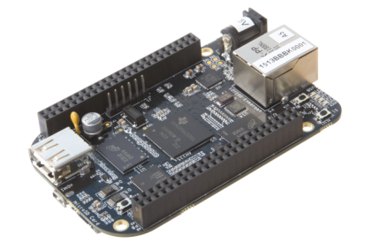
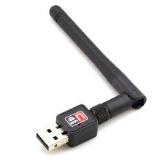
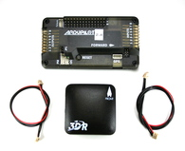
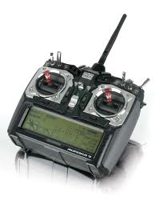
Drone Hardware Architecture
Overview
  Mobile Node
Three main components:
  Mobile Node
  Autopilot
  Airframe
MAVLink over
USB
Abort
Signal
  Autopilot
PWM
Commands
  Airframe

Slide 23
Airframe
Frame
Propellers
Motors
ESCs
Battery
Voltage Regulator
PWM
Commands

Slide 24
Autopilot
Autopilot
GPS/Compass
RC TX/RX
Ground Control Station (GCS)
MAVLink over
USB
PWM
Commands

Slide 25
Mobile Node
Beaglebone Black
WiFi
USB Hub
MAVLink over
USB

Slide 26
Outline
CentMesh Overview
CentMesh Drones Challenge Overview
Drone Hardware Architecture
Drone Software Architecture
SITL Introduction
Drone Programming 101
Drone Hardware Details

Slide 27
Software Architecture
Overview
MAVProxy
MAVLink
Sensing API

Slide 28
Software Architecture Overview
APM 2.6
Autopilot
Software
Airframe
PWM x 6
MAVLink over
USB
Beagle Bone Black
App
Laptop on the ground
UDP
ZZZ
MAVLink over
WiFi
MAVPROXY
GCS
MAVLink over
loopback
UDP
UDP
UDP
14550

Slide 29
MAVProxy
Autopilot
Software
Command line GCS
Also proxies and multiplexes commands to/from several GCSs (designed for GSC redundancy):
  Each MAVLink from a GCS/App forwarded to Autopilot (master)
  Each MAVLink from autopilot forwarded to GCS/App
Written in Python
MAVLink over
USB
MAVPROXY
MAVLink over
WiFi
UDP
UDP
UDP
To Laptop GCS
MAVLink over
loopback
UDP
QQQ
UDP
ZZZ
App 2
App 1

Slide 30
MAVLink Introduction
MAVLink is the only way to talk to the Autopilot.
MAVLink is a very lightweight, header-only message marshalling library for micro air vehicles⁽¹⁾.
Authoritative source of information: http://qgroundcontrol.org/mavlink/start
Library support for C/C++/C#, Python, WLua, JavaScript
Two versions defined: v0.9 and v1.0. We use v1.0.
(1) http://qgroundcontrol.org/mavlink/start

Slide 31
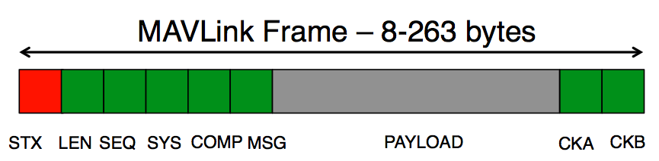
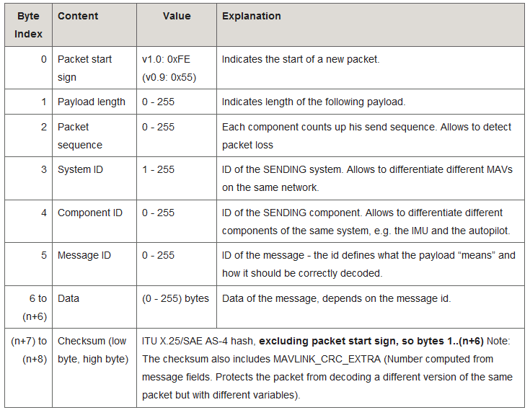
Packet Format

Slide 32
MAVLink XML to C/C++/Python
MAVLink is using XML definitions for all its messages.
There are generators to convert the XML to header files for C, C++, C#, and Python.
The resulting header files will have:
  a set of constants for any enums in the XML file
  a set of constants for the message identifiers
  a class for each type of MAVLink message defined in the XML file
  a MAVLink class, which can be used to send and receive messages
  within the MAVLink class, a _send and _decode function for each message type

Slide 33
Example of an
XML Heartbeat Message
Message ID:
0=Heartbeat
<message id="0" name="HEARTBEAT">
<description>The heartbeat message shows that a system is present and responding. The type of the MAV and Autopilot hardware allow the receiving system to treat further messages from this system appropriate (e.g. by laying out the user interface based on the autopilot).</description>
<field type="uint8_t" name="type">Type of the MAV (quadrotor, helicopter, etc., up to 15 types, defined in MAV_TYPE ENUM)</field>
<field type="uint8_t" name="autopilot">Autopilot type / class. defined in MAV_CLASS ENUM</field>
<field type="uint8_t" name="base_mode">System mode bitfield, see MAV_MODE_FLAGS ENUM in mavlink/include/mavlink_types.h</field>
<field type="uint32_t" name="custom_mode">Navigation mode bitfield, see MAV_AUTOPILOT_CUSTOM_MODE ENUM for some examples. This field is autopilot-specific.</field>
<field type="uint8_t" name="system_status">System status flag, see MAV_STATUS ENUM</field>
<field type="uint8_t_mavlink_version" name="mavlink_version">MAVLink version</field>
</message>
Field 1
Field 2
.
.
.
Field n

Slide 34
Corresponding C structure for the Heartbeat
#define MAVLINK_MSG_ID_HEARTBEAT 0
typedef struct __mavlink_heartbeat_t
{
uint32_t custom_mode; ///< Navigation mode bitfield, see MAV_AUTOPILOT_CUSTOM_MODE ENUM for some examples. This field is autopilot-specific.
uint8_t type; ///< Type of the MAV (quadrotor, helicopter, etc., up to 15 types, defined in MAV_TYPE ENUM)
uint8_t autopilot; ///< Autopilot type / class. defined in MAV_CLASS ENUM
uint8_t base_mode; ///< System mode bitfield, see MAV_MODE_FLAGS ENUM in mavlink/include/mavlink_types.h
uint8_t system_status; ///< System status flag, see MAV_STATUS ENUM
uint8_t mavlink_version; ///< MAVLink version
} mavlink_heartbeat_t;

Slide 35
Corresponding Python class
class MAVLink_heartbeat_message(MAVLink_message):
'''
The heartbeat message shows that a system is present and
responding. The type of the MAV and Autopilot hardware allow
the receiving system to treat further messages from this
system appropriate (e.g. by laying out the user interface
based on the autopilot).
'''
def __init__(self, type, autopilot, base_mode, custom_mode, system_status, mavlink_version):
MAVLink_message.__init__(self, MAVLINK_MSG_ID_HEARTBEAT, 'HEARTBEAT')
self._fieldnames = ['type', 'autopilot', 'base_mode', 'custom_mode', 'system_status', 'mavlink_version']
self.type = type
self.autopilot = autopilot
self.base_mode = base_mode
self.custom_mode = custom_mode
self.system_status = system_status
self.mavlink_version = mavlink_version
def pack(self, mav):
return MAVLink_message.pack(self, mav, 50, struct.pack('<IBBBBB', self.custom_mode, self.type, self.autopilot, self.base_mode, self.system_status, self.mavlink_version))

Slide 36
MAVLink Message Types Examples
All MAVLink message types 0-150 already defined
Message ids 0 – 149 are common for all autopilots
  <message id="0" name="HEARTBEAT">
  <message id="11" name="SET_MODE">
  <message id="24" name="GPS_RAW_INT">
  <message id="41" name="MISSION_SET_CURRENT">
  <message id="42" name="MISSION_CURRENT">
  <message id="46" name="MISSION_ITEM_REACHED">
  <message id="47" name="MISSION_ACK">
  <message id="76" name="COMMAND_LONG">
  <message id="77" name="COMMAND_ACK">
  <message id="147" name="BATTERY_STATUS">
Message ids 150-250 are autopilot specific, or custom

Slide 37
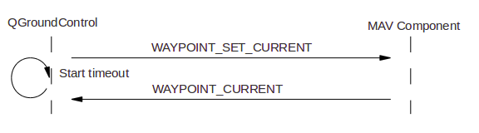
Common MAVLink Interactions
Listen for messages (e.g., heartbeat)
Send set messages and wait for confirmation:

Slide 38
C/C++ Packet Transmission Example
/* The default UART header for your MCU */
#include "uart.h"
#include <mavlink/include/common/common.h>
mavlink_system_t mavlink_system;
mavlink_system.sysid = 20; ///< ID 20 for this airplane
mavlink_system.compid = MAV_COMP_ID_IMU; ///< The component sending the message is the IMU, it could be also a Linux process
mavlink_system.type = MAV_TYPE_FIXED_WING; ///< This system is an airplane / fixed wing
// Define the system type, in this case an airplane
uint8_t system_type = MAV_TYPE_FIXED_WING;
uint8_t autopilot_type = MAV_AUTOPILOT_GENERIC;
uint8_t system_mode = MAV_MODE_PREFLIGHT; ///< Booting up
uint32_t custom_mode = 0; ///< Custom mode, can be defined by user/adopter
uint8_t system_state = MAV_STATE_STANDBY; ///< System ready for flight
// Initialize the required buffers
mavlink_message_t msg;
uint8_t buf[MAVLINK_MAX_PACKET_LEN];
// Pack the message
mavlink_msg_heartbeat_pack(mavlink_system.sysid, mavlink_system.compid, &msg, system_type, autopilot_type, system_mode, custom_mode, system_state);
// Copy the message to the send buffer
uint16_t len = mavlink_msg_to_send_buffer(buf, &msg);
// Send the message with the standard UART send function
// uart0_send might be named differently depending on
// the individual microcontroller / library in use.
uart0_send(buf, len);

Slide 39
C/C++ Packet Reception Example (1/2)
#include <mavlink/include/common/common.h>
// Example variable, by declaring them static they're persistent
// and will thus track the system state
static int packet_drops = 0;
static int mode = MAV_MODE_UNINIT; /* Defined in mavlink_types.h, which is included by mavlink.h */
/**
* @brief Receive communication packets and handle them
*
* This function decodes packets on the protocol level and also handles
* their value by calling the appropriate functions.
*/
static void communication_receive(void)
{
mavlink_message_t msg;
mavlink_status_t status;
// COMMUNICATION THROUGH EXTERNAL UART PORT (XBee serial)
while(uart0_char_available())
{
uint8_t c = uart0_get_char();
// Try to get a new message
if(mavlink_parse_char(MAVLINK_COMM_0, c, &msg, &status)) {
// Handle message

Slide 40
C/C++ Packet Reception Example (2/2)
switch(msg.msgid)
{
case MAVLINK_MSG_ID_HEARTBEAT:
{
// E.g. read GCS heartbeat and go into
// comm lost mode if timer times out
}
break;
case MAVLINK_MSG_ID_COMMAND_LONG:
// EXECUTE ACTION
break;
default:
//Do nothing
break;
}
}
// And get the next one
}
// Update global packet drops counter
packet_drops += status.packet_rx_drop_count;

Slide 41


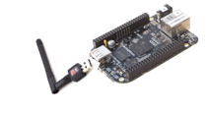
Sensing API
Big Picture

Slide 42
Sensing API
Allows the mobile nodes to send sensor data to CentMesh nodes;
Allows for delay tolerant reporting;
Allows for having zero, one or more connections from a drone to a mesh node at any one time;
Details on the protocol not needed for the challenge
Sensor
Mgr
Client
Comm
Comm
Server

Slide 43
Outline
CentMesh Overview
CentMesh Drones Challenge Overview
Drone Hardware Architecture
Drone Software Architecture
SITL Introduction
Drone Programming 101
Drone Hardware Details

Slide 44
Software In The Loop (SITL) introduction
To facilitate convenient programming we provide a software in the loop (SITL) emulation alternative to the real drone
The same application works for both the real drone and the emulation

Slide 45
Real Drone
APM 2.6
Autopilot
Software
Airframe
PWM x 6
MAVLink over
USB
Beagle Bone Black
App
Laptop on the ground
UDP
ZZZ
MAVLink over
WiFi
MAVPROXY
GCS
MAVLink over
loopback
UDP
UDP
UDP
14550

Slide 46
SITL Setup
UDP
Physics Simulation
sim_multicopter.py
One Linux PC
(or VCL Image)
SITL Executable (Arducopter compiled for PC)
UDP
5502
UDP
UDP
5501
UDP
5503
MAVLink over
TCP 5770
Direct RC Commands
UDP
App
FlightGear
Visualization
UDP
ZZZ
MAVLink over
WiFi
UDP
GCS
MAVPROXY
MAVLink over
loopback
UDP
UDP
UDP
14550

Slide 47
SITL Setup
It’s a relatively elaborate setup. Two options:
  Use the VCL image we prepared for you
  Roll your own

Slide 48
SITL VCL Image
Point your browser to http://vcl.ncsu.edu
Login with your Unity username and password
Select the image “APM_Copter_3DRobotics_SITL_Image”
  If you don’t see it, you probably didn’t register for the event – register and email us and we’ll give you access.
Make a reservation
When that’s done, login with username “droneusr”, and password “drone123”

Slide 49
SITL Setup
Double click start_SITL.sh – it will open one terminal with four tabs and qgroundcontrol:
  Tab 1: AUTOPILOT
    Arducopter.elf
  Tab 2: PHYSICS_SIMULATION
    sim_multicopter.py --frame=+ --home=35.7713121,-78.6743912,584,270"
  Tab 3: MAVPROXY
    mavproxy.py --master tcp:127.0.0.1:5760 --sitl 127.0.0.1:5501 --out 127.0.0.1:14550 –quadcopter
    Use it to control the drone manually
  Tab 4: QGroundControl Station
    qgroundcontrol
Start your application in a different terminal or a different tab.

Slide 50
Setting your own SITL image
Start with a Linux image (Ubuntu recommended)
Follow the instructions on the CentMesh Wiki -> Resource Specifications -> Autopilot details -> SITL details: http://centmesh.csc.ncsu.edu/trac/MeshBed/wiki/Hardware/Drones/Autopilot/sitl

Slide 51
Outline
CentMesh Overview
CentMesh Drones Challenge Overview
Drone Hardware Architecture
Drone Software Architecture
SITL Introduction
Drone Programming 101
Drone Hardware Details

Slide 52

Socket programming
goal: learn how to build client/server applications that communicate using sockets
socket: door between application process and end-end-transport protocol
application
socket
application
controlled by
app developer
process
process
transport
transport
network
network
controlled
by OS
link
Internet
link
physical
physical

Slide 53
Socket programming
  Two socket types for two transport services:
  UDP: unreliable datagram
  TCP: reliable, byte stream-oriented
  Application Example:
Client reads a line of characters (data) from its keyboard and sends the data to the server.
The server receives the data and converts characters to uppercase.
The server sends the modified data to the client.
The client receives the modified data and displays the line on its screen.

Slide 54
Socket programming with UDP
UDP: no “connection” between client & server
no handshaking before sending data
sender explicitly attaches IP destination address and port # to each packet
rcvr extracts sender IP address and port# from received packet
UDP: transmitted data may be lost or received out-of-order
Application viewpoint:
UDP provides unreliable transfer of groups of bytes (“datagrams”) between client and server

Slide 55
Client/server socket interaction: UDP
server (running on serverIP)
client
create socket:
create socket, port= x:
clientSocket =
socket(AF_INET,SOCK_DGRAM)
serverSocket =
socket(AF_INET,SOCK_DGRAM)
Create datagram with server IP and
port=x; send datagram via
clientSocket
read datagram from
serverSocket
write reply to
serverSocket
specifying
client address,
port number
read datagram from
clientSocket
close
clientSocket
Application 2-55

Slide 56
Example app: UDP client
Python UDPClient
include Python’s socket
library
from socket import *
serverName = ‘hostname’
serverPort = 12000
clientSocket = socket(socket.AF_INET,
socket.SOCK_DGRAM)
message = raw_input(’Input lowercase sentence:’)
clientSocket.sendto(message,(serverName, serverPort))
modifiedMessage, serverAddress =
clientSocket.recvfrom(2048)
print modifiedMessage
clientSocket.close()
create UDP socket for server
get user keyboard
input
Attach server name, port to message; send into socket
read reply characters from
socket into string
print out received string and close socket

Slide 57
Example app: UDP server
Python UDPServer
create UDP socket
from socket import *
serverPort = 12000
serverSocket = socket(AF_INET, SOCK_DGRAM)
serverSocket.bind(('', serverPort))
print “The server is ready to receive”
while 1:
message, clientAddress = serverSocket.recvfrom(2048)
modifiedMessage = message.upper()
serverSocket.sendto(modifiedMessage, clientAddress)
bind socket to local port number 12000
loop forever
Read from UDP socket into message, getting client’s address (client IP and port)
send upper case string back to this client

Slide 58
Sample Application 1
Reading MAVLink Heartbeats
Puts the drone in AUTO mode (in this mode it flies through a list of predefined waypoints) and then arms it.
You need to give the drone a bit of throttle to allow it to take off – do that via “rc 3 1300” in the MAVProxy command line interface
Receives GPS readings as MAVLink packets
Saves them into a file every 5 seconds.
Available as uav_auto_mode.py under the $HOME/sample_prog/program_1 directory in the VCL image.

Slide 59
Sample Application 1 – Part 1
#!/usr/bin/python
"""
This program sets the UAV in AUTO mode. It reads the GPS information and
writes the most recent entry to a file. This entry is read by the CentMesh
sensing APP which saves it to a server.
"""
import re, sys, os, socket, select, time
import tempfile
from datetime import datetime
sys.path.insert(0,os.path.join(os.path.dirname(os.path.realpath(__file__)),'../lib'))
import mavlink_apm, FTL_util
# The following will be used in figuring out when to print GPS info
INTERVAL = 5
new_time = current_time = datetime.now()
#This sample application writes the current GPS reading to this file,
# overwriting the previous entry. This file is used by sensor application
file_gps_data_for_sensing_app = "/tmp/gps_data"
# Object used for accessing utility functions
FTL_util_obj = FTL_util.FTL_util()
MAX_SIZE = 1024
Inserts ../lib into PATH to allow imports of mavlink_apm, and FTL_util
more MAVLink utilities
mavlink library

Slide 60
Sample Application 1 – Part 2
"""Utility function: checks if the given filename exists and warns the user
if there exists one"""
def check_file_name_exists(file_name_provided):
if os.path.exists(file_name_provided):
print "The provided file name %s exists. Do you wish to overwrite it?(y/n)" % file_name_provided
while 1:
data = sys.stdin.readline()
if not data.lower() == 'y\n'.lower() and not data.lower() == 'n\n'.lower():
print 'Please enter \"y\" or \"n\"'
continue
elif data.lower() == 'n':
print "Quitting..please try again"
sys.exit(1)
else:
with open(file_name_provided, "w") as file_reference:
file_reference.close()
break

Slide 61
Sample Application 1 – Part 3
""" Print GPS info, this function is invoked every time a hearbeat message
is received. The function saves only if the last 'save' has happened
at least 5 seconds ago. Independent of this save, the value is written to a temporary file /tmp/gps_data. This file is used by the sensing application"""
def save_gps_info (decoded_message, file_gps_info):
global current_time, new_time, last_gps_info_saved, FTL_util_obj, MAX_SIZE
global file_gps_data_for_sensing_app
last_gps_info_saved = str(decoded_message)
with tempfile.NamedTemporaryFile(
'w', dir=os.path.dirname(file_gps_data_for_sensing_app), delete=False) as tf:
tf.write(last_gps_info_saved)
tempname = tf.name
os.rename(tempname, file_gps_data_for_sensing_app)
# Check if we need to save it to the provided file name
new_time = datetime.now()
if (new_time - current_time).seconds >= int(INTERVAL):
print "Time to save!!!!"
with open(file_gps_info, "a") as file_reference:
file_reference.write("\n" + str(decoded_message))
file_reference.close()
# Update the current timers
current_time = new_time

Slide 62
Sample Application 1 – Part 4
""" Get address of MAVProxy """
def get_mavproxy_address (mav_obj,mavproxy_sock):
heartbeat_received = 'False'
mavproxy_sock.setblocking(1)
print "Waiting for heartbeat message..."
while not heartbeat_received.lower() == 'TRUE'.lower():
# Wait for heartbeat message to get the remote address
# used by MAVProxy
try:
data_from_mavproxy,address_of_mavproxy = mavproxy_sock.recvfrom (MAX_SIZE)
except socket.error as v:
print "Exception when trying to obtain address of MAVProxy"
print os.strerror(v.errno)
decoded_message = mav_obj.decode(data_from_mavproxy)
msg_id = decoded_message.get_msgId()
if msg_id == mavlink_apm.MAVLINK_MSG_ID_HEARTBEAT:
# Undo the change made
heartbeat_received = 'True'
print 'Got the address of MAV, proceeding..'
print address_of_mavproxy
mavproxy_sock.setblocking(0)
return address_of_mavproxy
Waits to receive a heartbeat before trying to set AUTO mode or read anything else
What we received is a heartbeat

Slide 63
Sample Application 1 – Part 5
""" The main function """
def main():
# Use the global values for MAX_SIZE and INTERVAL
global MAX_SIZE, INTERVAL
file_gps_info = ""
if len(sys.argv) != 3:
print "Usage: ./uav_auto_mode.py <MAVProxy port> <File_to_save_GPS_info>"
sys.exit(1)
mavproxy_port = int(sys.argv[1])
print "MAVProxy port is %d" % mavproxy_port
file_gps_info = sys.argv[2]
Extracts port for MAVProxy and file to save the GPS info from the command line arguments and handles errors

Slide 64
Sample Application 1 – Part 6
try:
HOST = ''
# Create a server socket for MAVProxy
mavproxy_sock = socket.socket (socket.AF_INET,socket.SOCK_DGRAM)
print 'created UDP socket for MAVProxy'
mavproxy_sock.setblocking(0)
mavproxy_sock.bind((HOST,mavproxy_port))
print 'Binding socket for MAVProxy connection'
# Create the mavproxy object
mav_obj = mavlink_apm.MAVLink (mavproxy_sock)
except Exception as ex:
template = "An exception of type {0} occured. Arguments:\n{1!r}"
message = template.format(type(ex).__name__, ex.args)
print message
sys.exit(1)
# File name check
check_file_name_exists(file_gps_info)
Opens a UDP socket on the port specified by command line;
Creates a mav_object bound to the port

Slide 65
Sample Application 1 – Part 7
#Get the address of mavproxy
address_of_mavproxy = get_mavproxy_address (mav_obj, mavproxy_sock)
return_status = FTL_util_obj.set_mav_mode(FTL_util_obj.auto_mode,mav_obj,
mavproxy_sock, address_of_mavproxy)
if return_status < 0:
print "Error while setting mode, please check the parameters passed..."
sys.exit(1)
Waits for Heartbeat
Puts the MAV in AUTO mode

Slide 66
Sample Application 1 – Part 8
# ARM the UAV
component_id = mavlink_apm.MAV_COMP_ID_SYSTEM_CONTROL
# Same command for arming or disarming, arm_flag controls whether the UAV
# armed or disarmed. arm_flag=1->arm, arm_flag=0->disarm
command = mavlink_apm.MAV_CMD_COMPONENT_ARM_DISARM
arm_flag = 1
# Number of confirmations needed for this command. 0 means immediately
confirmation = 0
# Other parameters are ignored by this command and are to be set to zero.
PARAM_IGNORE = 0
msg = mav_obj.command_long_encode (1,component_id,command,confirmation,
arm_flag,PARAM_IGNORE,PARAM_IGNORE,
PARAM_IGNORE,PARAM_IGNORE,PARAM_IGNORE,
PARAM_IGNORE)
try:
mavproxy_sock.sendto(msg.get_msgbuf(),(address_of_mavproxy))
except socket.error as v:
print "Exception when trying to ARM the copter:"
print os.strerror(v.errno)
print "ARMED"
make the arming message
send the message

Slide 67
Sample Application 1 – Part 10
# 'Listen' passively for messages from MAVProxy and filter
# messages with GPS information.
list_read_sockets = [mavproxy_sock]
list_write_sockets = []
list_error_sockets = []
while 1:
readable, writable, error = select.select(list_read_sockets,
list_write_sockets,
list_error_sockets,
int(INTERVAL))
if readable:
# print "Data received from MAVProxy!!!!"
data_from_mavproxy,address_of_mavproxy = mavproxy_sock.recvfrom (MAX_SIZE)
decoded_message = mav_obj.decode(data_from_mavproxy)
msg_id = decoded_message.get_msgId()
# Check if this information is GPS information.
if msg_id == mavlink_apm.MAVLINK_MSG_ID_GPS_RAW_INT:
save_gps_info(decoded_message, file_gps_info)
else:
print 'select() timeout, continue...'
continue
if __name__ == '__main__':
main()

Slide 68
Utility Functions
Implement common functionality
  Mode enumerators (a dictionary) for Arducopter (APM)
  Setting the MAV mode for APM,
  Reading the mode from the heartbeat
Available in the VCL Image in $HOME/sample_prog/lib

Slide 69
Utility Functions – Part 1
"""Constructor for the class. Takes nothing as argument and initializes
the dictionary mapping for <custom_mode>->mode name"""
def __init__(self):
self.dict_mode_names[0] = self.stabilize_mode
self.dict_mode_names[1] = self.acro_mode
self.dict_mode_names[2] = self.alt_hold_mode
self.dict_mode_names[3] = self.auto_mode
self.dict_mode_names[4] = self.guided_mode
self.dict_mode_names[5] = self.loiter_mode
self.dict_mode_names[6] = self.rtl_mode
self.dict_mode_names[7] = self.circle_mode
self.dict_mode_names[8] = self.position_mode
self.dict_mode_names[9] = self.land_mode
self.dict_mode_names[10] = self.of_loiter_mode
self.dict_mode_names[11] = self.approach_mode
import re, sys, os, socket, select, time
import mavlink_apm
class FTL_util:
dict_mode_names = {}
# mode names for APM
# We can save this in the following way: x1,x2,x3 = A,B,C. But for
# readability sake, we stick to this format
stabilize_mode = 'STABILIZE'
auto_mode = 'AUTO'
guided_mode = 'GUIDED'
rtl_mode = 'RTL'
land_mode = 'LAND'
of_loiter_mode = 'OF_LOITER'
alt_hold_mode = 'ALT_HOLD'
loiter_mode = 'LOITER'
position_mode = 'POSITION'
circle_mode = 'CIRCLE'
approach_mode = 'APPROACH'
acro_mode = 'ACRO'
MAX_SIZE = 1024

Slide 70
Utility Functions – Part 2
"""Destructor for the class, we do nothing here """
def __del__(self):
pass
"""Internal function: Given the base mode and custom mode, this
function function returns the string for relevant mode. We are doing
this as a different function as we may need to add some functionality
here later.
UPDATE: We are currently using only the custom_mode. We may update
this part if the custom_mode is found to be insufficient"""
def __return_mav_mode__(self, base_mode, custom_mode):
if (custom_mode) in self.dict_mode_names:
return self.dict_mode_names[custom_mode]
else:
return ""
""" Internal function to get the custom_mode corresponding to a string.
If mode is not found, returns -1 """
def __return_custom_mode__(self, mode_str):
# Get the value of custom_mode corresponding to the string passed
for key,value in self.dict_mode_names.items():
if value == mode_str:
return key
return -1

Slide 71
Utility Functions – Part 3
""" Function that receives the mode as a string and sets the mode.
Returns 0 on success, -1 on failure"""
def set_mav_mode(self,mode_str,mav_obj,mavproxy_sock,address_of_mavproxy):
custom_mode = self.__return_custom_mode__(mode_str)
# Basic error checking
if custom_mode == -1 or not mav_obj or not mavproxy_sock or not address_of_mavproxy:
return -1
msg = mav_obj.set_mode_encode(1, 1, custom_mode)
list_read_sockets = [mavproxy_sock]
list_write_sockets = list_error_sockets = []

Slide 72
Utility Functions – Part 4
# Do not proceed until the MAV is set to the given mode
while 1:
try:
mavproxy_sock.sendto(msg.get_msgbuf(),(address_of_mavproxy))
data_from_mavproxy,address_of_mavproxy = mavproxy_sock.recvfrom (self.MAX_SIZE)
except socket.error as v:
print "Exception when trying to set AUTO mode:"
print os.strerror(v.errno)
time.sleep(1)
continue
decoded_message = mav_obj.decode(data_from_mavproxy)
msg_id = decoded_message.get_msgId()
# we are interested only if this is the heartbeat
if msg_id == mavlink_apm.MAVLINK_MSG_ID_HEARTBEAT:
# Get the mode from the message
mode = self.get_mav_mode(str(decoded_message))
if mode.lower() == mode_str.lower():
print "Mode set as expected"
return 0
else:
continue

Slide 73
Utility Functions – Part 5
""" Function that receives the heartbeat message as a string
and extracts base_mode and custom_mode."""
def get_mav_mode (self, heartbeat_message):
print "heartbeat message is %s" % heartbeat_message
# Get base_mode
match_for_base_mode = re.search(r'base_mode : (.+?),',heartbeat_message)
if not match_for_base_mode:
print "Error - no base_mode found, return!"
return ""
else:
base_mode = match_for_base_mode.group(1)
# Get custom_mode
match_for_custom_mode = re.search(r'custom_mode : (.+?),',heartbeat_message)
if not match_for_custom_mode:
print "Error - no custom_mode found, return!"
return ""
else:
custom_mode = match_for_custom_mode.group(1)
return self.__return_mav_mode__(int(base_mode),int(custom_mode))

Slide 74
Sample Application 2
Sending MAVLink GUIDED commands
Puts the drone in AUTO mode (in this mode it flies through a list of predefined waypoints) and then arms it.
You need to give the drone a bit of throttle to allow it to take off – do that via “rc 3 1300” in the MAVProxy command line interface
Reads the GPS coordinates from the file we wrote in application 1
Sends a GUIDED command to the coordinates in the file every 5 seconds
At the end of the file it puts the drone in returns to launch (RTL) mode.

Slide 75
Sample Application 2 – Part 1
#!/usr/bin/python
"""
This program reads the RAW GPS readings from a file every INTERVAL seconds, converts them to GPS coordinates and directs the uav to traverse to those. After all the waypoints are traversed, it sets the UAV to RTL mode.
"""
import re
import sys, os
import socket
import select
import time
sys.path.insert(0, os.path.join(os.path.dirname(os.path.realpath(__file__)), '../lib'))
import mavlink_apm, FTL_util
INTERVAL = 5
MAX_SIZE = 1024
# Following are used for converting RAW GPS data into GPS coordinates
raw_int_to_float_lat_lon = 10**7
raw_int_to_float_alt = 10**3
# Object used for accessing utility functions
FTL_util_obj = FTL_util.FTL_util()
Initialization

Slide 76
Sample Application 2 – Part 2
""" This function sets the next waypoint the UAV has to traverse to"""
def send_wp (mav_obj, mavproxy_sock, latitude, longitude,altitude,
address_of_mavproxy):
global MAX_SIZE, INTERVAL
# A simpler way of assigning would be a,b,c,d = p1,p2,p3,p4. But for
# readability sake, we stick with the usual assignment
target_system = target_component = 1
seq = 0
frame = mavlink_apm.MAV_FRAME_GLOBAL_RELATIVE_ALT
command = mavlink_apm.MAV_CMD_NAV_WAYPOINT
current = 2
autocontinue = mavlink_apm.MAV_GOTO_DO_CONTINUE # continue to next waypoint
param1 = param2 = param3 = param4 = PARAM_IGNORE = 0
# Send the waypoint message and wait utill the ACK is received for 2 seconds
list_read_sockets = [mavproxy_sock]
list_write_sockets = list_error_sockets = []
For which UAV and component is this message.
Ours is 1, for the challenge each team will have a different number (team number)

Slide 77
Sample Application 2 – Part 3
while 1:
msg = mav_obj.mission_item_encode(target_system, target_component,seq,frame,command,current,autocontinue,param1,param2,param3,param4,latitude,longitude,altitude - 584.0)
try:
mavproxy_sock.sendto(msg.get_msgbuf(),(address_of_mavproxy))
except socket.error as v:
print "Exception when setting WP:"
print os.strerror(v.errno)
time.sleep(1)
continue
readable, writable, error = select.select(list_read_sockets,
list_write_sockets,
list_error_sockets,INTERVAL)
if readable:
data_from_mavproxy,address_of_mavproxy = mavproxy_sock.recvfrom (MAX_SIZE)
decoded_message = mav_obj.decode(data_from_mavproxy)
msg_id = decoded_message.get_msgId()
# Check if this is a waypoint request message
if msg_id == mavlink_apm.MAVLINK_MSG_ID_MISSION_ACK:
print 'ACK for this way-point received received...'
break
else:
#print "Expected message ID 47, received %d" % msg_id
continue
else:
# Send the message again
print "Timeout on receiving waypoint ACK message"
continue
return
Ugly conversion between absolute altitude (from GPS) and relative altitude (needed for GUIDED mode)

Slide 78
Sample Application 2 – Part 4
""" This function parses the RAW GPS data and returns latitude, longitude
and altitude"""
def parse_gps_info(gps_info):
latitude = longitude = altitude = 0
# Get Latitude
match_for_latitude = re.search(r'lat : (.+?),',gps_info)
if not match_for_latitude:
print "Error - no latitude information found, return!"
return 0,0,0
else:
latitude = match_for_latitude.group(1)
# Get longitude
match_for_longitude = re.search(r'lon : (.+?),',gps_info)
if not match_for_longitude:
print "Error - no longitude information found, return!"
return 0,0,0
else:
longitude = match_for_longitude.group(1)
# Get altitude
match_for_altitude = re.search(r'alt : (.+?),',gps_info)
if not match_for_altitude:
print "Error - no altitude information found, return!"
return 0,0,0
else:
altitude = match_for_altitude.group(1)
return latitude, longitude, altitude
Altitude is the one returned by GPS, i.e., absolute

Slide 79
Sample Application 2 – Part 5
""" This function is invoked to obtain the address of MAVProxy"""
def get_mavproxy_address (mav_obj,mavproxy_sock):
MAX_SIZE = 1024
heartbeat_received = 'False'
mavproxy_sock.setblocking(1)
print "Waiting for heartbeat message..."
while not heartbeat_received.lower() == 'TRUE'.lower():
# Wait for heartbeat message to get the remote address
# used by MAVProxy
try:
data_from_mavproxy,address_of_mavproxy = mavproxy_sock.recvfrom (MAX_SIZE)
except socket.error as v:
print "Exception when trying to obtain address of MAVProxy"
print os.strerror(v.errno)
decoded_message = mav_obj.decode(data_from_mavproxy)
msg_id = decoded_message.get_msgId()
if msg_id == mavlink_apm.MAVLINK_MSG_ID_HEARTBEAT:
# Undo the change made
heartbeat_received = 'True'
print 'Got the address of MAV, proceeding..'
print address_of_mavproxy
mavproxy_sock.setblocking(0)
return address_of_mavproxy
Same as application 1:
Blocks until it receives a heartbeat from MAVProxy.

Slide 80
Sample Application 2 – Part 6
""" The main function """
def main():
global MAX_SIZE, raw_int_to_float_lat_lon, raw_int_to_float_alt
file_handle = ""
if len(sys.argv) != 3:
print "Usage: ./uav_guided_mode.py <MAVProxy port> <path to file with GPS info>"
sys.exit(1)
mavproxy_port = int(sys.argv[1])
file_name_with_gps_info = sys.argv[2]
# Check if the file exists
if not os.path.exists(file_name_with_gps_info):
print "File name %s does not exist" % file_name_with_gps_info
sys.exit(1)
# Check if the file is not empty
if not (os.path.getsize(file_name_with_gps_info) > 0):
print "File %s is empty" % file_name_with_gps_info
sys.exit(1)
Command line arguments processing, error checking

Slide 81
Sample Application 2 – Part 7
try:
HOST = '' # Listen on all interfaces
# Create a server socket for MAVProxy
mavproxy_sock = socket.socket (socket.AF_INET,socket.SOCK_DGRAM)
mavproxy_sock.setblocking(0)
print 'created UDP socket for MAVProxy'
mavproxy_sock.bind((HOST,mavproxy_port))
print 'Binding socket for MAVProxy connection'
# Create the mavproxy object
mav_obj = mavlink_apm.MAVLink (mavproxy_sock)
# Get the address used by MAVProxy
address_of_mavproxy = get_mavproxy_address (mav_obj, mavproxy_sock)
Initializes the socket and the mav_object

Slide 82
Sample Application 2 – Part 8
# ARM the UAV
component_id = mavlink_apm.MAV_COMP_ID_SYSTEM_CONTROL
# Same command for arming or disarming, arm_flag controls whether the UAV
# armed or disarmed. arm_flag=1->arm, arm_flag=0->disarm
command = mavlink_apm.MAV_CMD_COMPONENT_ARM_DISARM
arm_flag = 1
# Number of confirmations needed for this command. 0 means immediately
confirmation = 0
# Other parameters are ignored by this command and are to be set to zero.
PARAM_IGNORE = 0
msg = mav_obj.command_long_encode (1,component_id,command,confirmation, arm_flag,PARAM_IGNORE,PARAM_IGNORE, PARAM_IGNORE,PARAM_IGNORE,PARAM_IGNORE,
PARAM_IGNORE)
try:
mavproxy_sock.sendto(msg.get_msgbuf(),(address_of_mavproxy))
except socket.error as v:
print "Exception when trying to ARM the copter:"
print os.strerror(v.errno)
print "ARMED"
file_handle = open(file_name_with_gps_info, 'r')

Slide 83
Sample Application 2 – Part 9
# For each line which represents raw GPS data, generate and set a waypoint
for line in file_handle:
# Skip empty lines
if line not in ['\n','\r\n']:
latitude, longitude, altitude = parse_gps_info(line)
# Filter unexpected values
if not longitude or not latitude or not altitude:
print "Erroneous values, skip.."
continue
latitude = float(latitude)/raw_int_to_float_lat_lon
longitude = float(longitude)/raw_int_to_float_lat_lon
altitude = float(altitude)/raw_int_to_float_alt
send_wp (mav_obj, mavproxy_sock, latitude,longitude,
altitude,address_of_mavproxy)
# Sleep for INTERVAL seconds
time.sleep(float(INTERVAL))
return_status = FTL_util_obj.set_mav_mode(FTL_util_obj.rtl_mode,mav_obj,
mavproxy_sock, address_of_mavproxy)
if return_status < 0:
print "Error while setting mode, please check the parameters passed..."
sys.exit(1)
except Exception as ex:
template = "An exception of type {0} occured. Arguments:\n{1!r}"
message = template.format(type(ex).__name__, ex.args)
print message
sys.exit(1)
if file_handle:
file_handle.close()
if __name__ == '__main__':
main()

Slide 84
Outline
CentMesh Overview
CentMesh Drones Challenge Overview
Drone Hardware Architecture
Drone Software Architecture
SITL Introduction
Drone Programming 101
Drone Hardware Details

Slide 85
Airframe
Frame
Propellers
Motors
ESCs
Battery
Voltage Regulator
PWM
Commands

Slide 86

Frame
HexCopter
Supports the rest of the components.

Slide 87
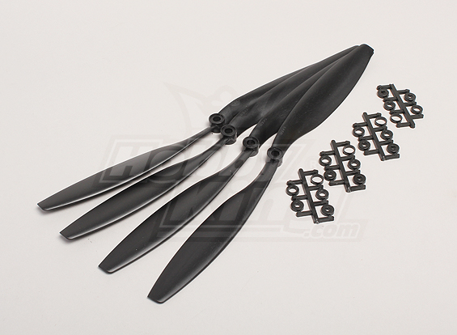
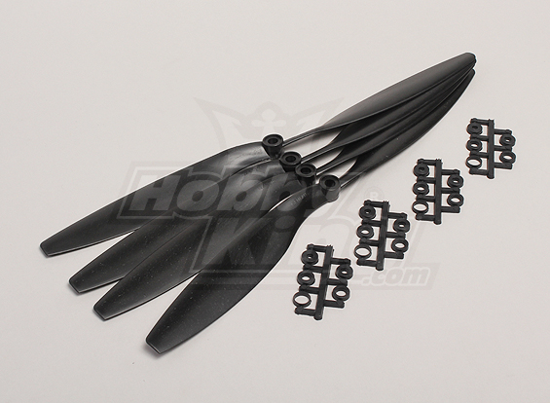
Propellers
12 x 4.5
Flimsy (for safety)
Three clockwise
Three counter-clockwise

Slide 88
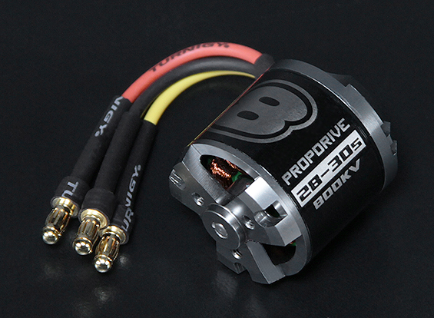
Motors
Model: NTM Prop Drive Series 28-30A 800kv (short shaft version)
Kv: 800rpm/v
Max current: 20A
Max Power: 300W
Shaft: 3mm
Weight: 65g
ESC: 20~30A
Cell count: 3s~6s LiPo
Bolt holes: 16mm & 19mm
Bolt thread: M3
Connection: 3.5mm Bullet-connector
Prop Tests:
8x4E - 22.2V / 310W / 13.9A / 1.11kg thrust
10x5E - 18.5V / 315W / 17.3A / 1,27kg thrust
11x7E - 14.8V / 260W / 17.8A / 1.05kg thrust
12x6E - 14.8V / 276W / 18.7A / 1.20kg thrust

Slide 89
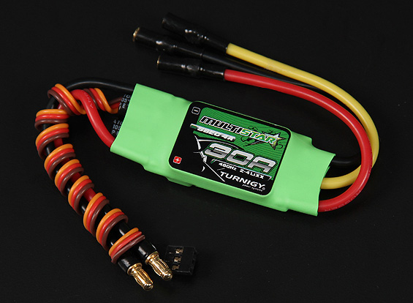
Electronic Speed Controller
(ESC)
From LiPo Battery
-
Controls power delivery to motors (from 0% to 100%)
Signal from Autopilot: PWM (standard servo)
BEC needs to be disabled – we disconnect the red wire to the autopilot (as we power the autopilot from a different source)
Switching any two of the wires to the motor
Needs setup (break, timing, cells, etc.)
Needs calibration (defines 100%)
+
Signal
+
-
To Motor
To/From Autopilot

Slide 90
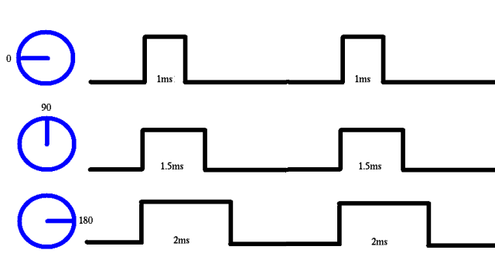
Pulse Width Modulation (PWM)
Throttle Off (0%)
Throttle at 50%
Throttle at 100%
Signal
From Autopilot

Slide 91

Battery
3 cell Lithium Polymer battery (11.2V nominal – 10.6 when discharged, 12.6V when charged) – all voltages not when under load
Has to be charged by using special charger (prevents overcharging).
Can burst into flames if:
  Charged too fast (charge at less than 4A)
  Charged too much (charger monitors that)
  Discharged too fast (e.g., short)
  Hit
  Heated
Permanently damaged (loses all capacity) if over-discharged

Slide 92
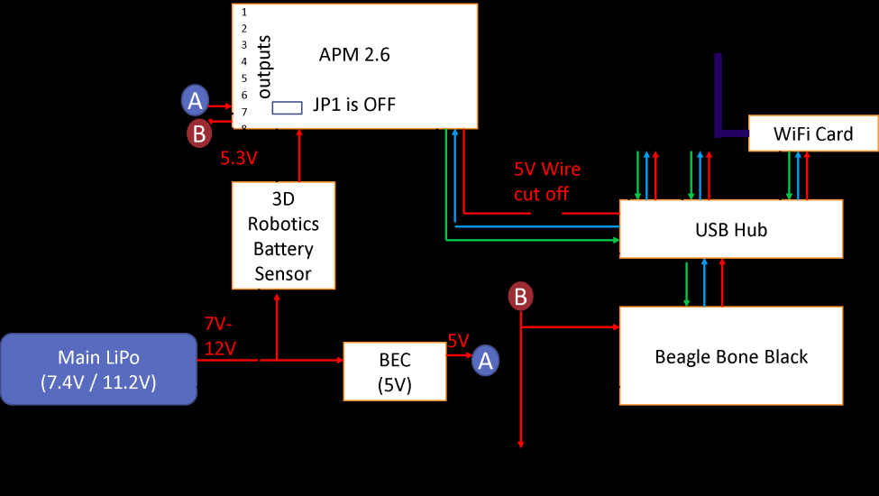
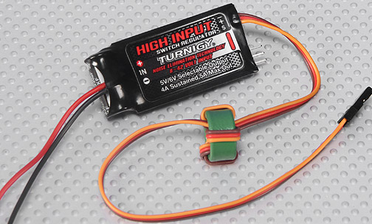
5V Regulator (BEC)
Powers all electronics except for the autopilot.
The autopilot is powered from the battery sensor (which also offers power to the autopilot)
Capable of delivering up to 5A continuous (our setup is well under that load)

Slide 93
Autopilot
Autopilot
GPS/Compass
RC TX/RX
Ground Control Station (GCS)
MAVLink over
USB
PWM
Commands

Slide 94
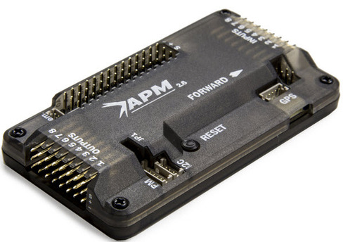
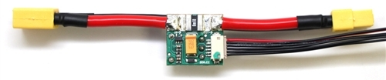
Autopilot
ArduCopter – open source autopilot
Stabilizes the drone (uses an on-board IMU unit)
Navigates the drone (uses barometer, GPS and compass)
A battery monitoring unit allows for failsafe landings on low battery.
Requires extensive calibration and setup – documentation on CentMesh wiki
Power module measures voltage, current, and powers the APM at the odd voltage of 5.3V

Slide 95
Autopilot modes
Stabilize (manual control)
Alt(itude) hold (fixed Z)
Loiter aka stationkeep (keep fixed X,Y,Z)
Land (reduce Z until barometer detects descending rate <20cm/s and disarm)
Return to Launch (RTL) – first climb to a prespecified altitude (RTL_ALTITUDE), then return to the arming position (HOME)
Guided Mode (GOTO position)
Auto Mode: Execute a script including waypoints, ending in Land, RTL or Loiter.

Slide 96
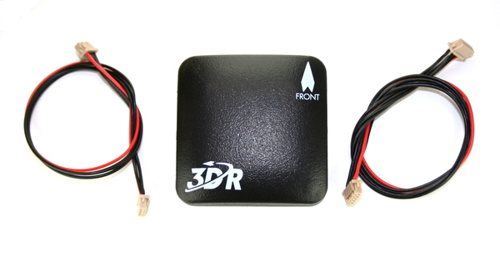
GPS/Compass
Critical for Navigation
Has to be mounted far from electrical noise (for GPS), and far from magnetic noise (produced by varying currents) for compass
Without GPS there is no way to navigate
With bad compass the drone “toilet-bowls”

Slide 97
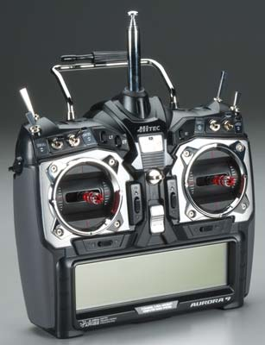
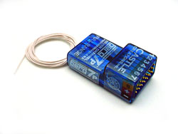
RC Transmitter/Receiver
Allows us to bypass the mobile node to setup and test the drones
Allows for aborting the mission if the mobile node crashes: the receiver plugs directly into the autopilot which then can ignore input from the mobile node
Allows to change the mode manually – not used in the challenge
Allows for additional inputs in most modes (meaning of input depends on mode)

Slide 98
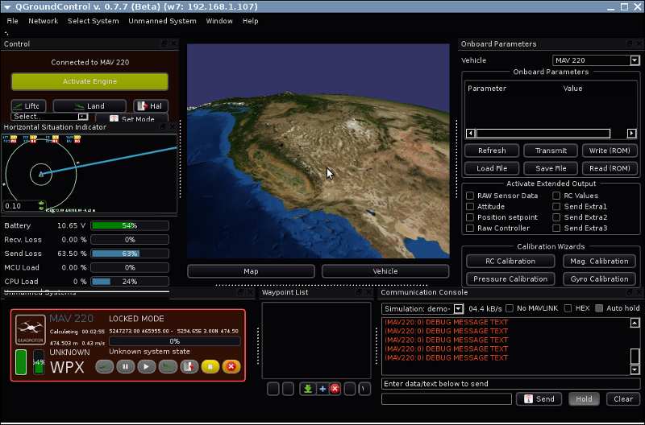
Ground Control Station (GCS)
See the status of a drone
Issue commands to a drone
Drone setup
Mission replay (after mission)
Retrieve and plot log files (from autopilot)
Connects (somehow) to the drone – in our case through the mobile node and MAVProxy (details soon)

Slide 99
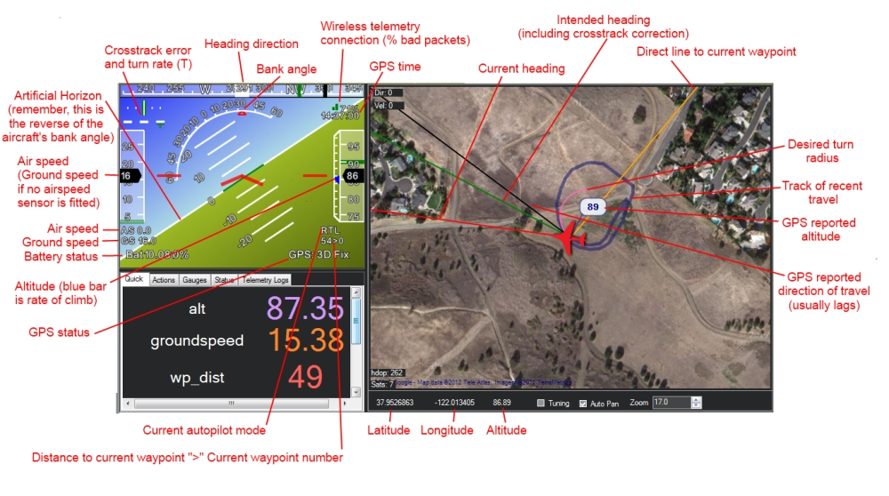
GCS Options
Mission Planner – official, Windows, works
QGroundControl - open source, multiplatform, read only at this time
MAVProxy – open source, python, command line (!)
APM Planner – beta – combination of MissionPlanner, QGroundControl

Slide 100
Mobile Node
Beaglebone Black
WiFi
USB Hub
MAVLink over
USB

Slide 101
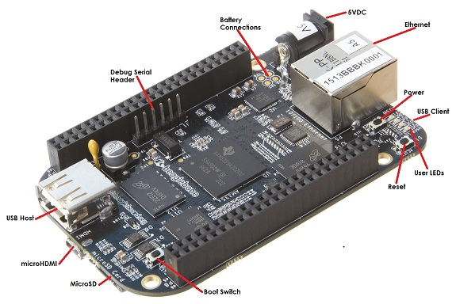
Beaglebone Black
Processor: AM335x 1GHz ARM® Cortex-A8
  512MB DDR3 RAM
  2GB 8-bit eMMC on-board flash storage
  3D graphics accelerator
  NEON floating-point accelerator
  2x PRU 32-bit microcontrollers
Connectivity
  USB client for power & communications
  USB host
  Ethernet
  HDMI
  2x 46 pin headers
$45 MSRP
Ångström Linux

Slide 102
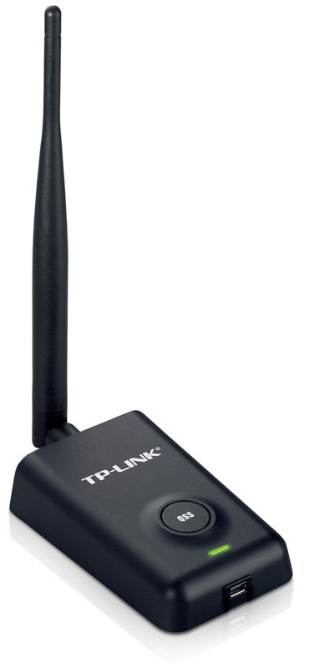
WiFi Card
TP-LINK TL-WN7200ND Wireless N150 High Power USB Adapter, 500mw, 5dBi High Gain Detachable Antenna, 802.1b/g/n, WEP, WPA/WPA2
Supports ad-hoc mode

Slide 103
Next Steps
Get Your Hands Wet
Other Useful Info
VCL image users:
  APM_Copter_3DRobotics_SITL_Image
  (VCL: Must use same IP to access as used to reserve)
Roll your own:
  centmesh.csc.ncsu.edu → wiki → “Resource Specifications” → “CentMesh Mobile Node detail”
  Download and install SITL, MAVProxy, …
Post questions on Googlegroup
  Hardware
  Software tools and environment setup
  Application Development and Debugging, MAVLINK
  Miscellaneous
We will be recording this session (audience audio-only)
Sign in if you have not, sign waivers if you have not

Slide 104
Resources
Drones Challenge Website: http://centmesh.csc.ncsu.edu/drones_challenge.html
CentMesh Website: http://centmesh.csc.ncsu.edu
CentMesh Wiki: http://centmesh.csc.ncsu.edu/trac/MeshBed/wiki
Drone Challenge Google Group: https://groups.google.com/forum/#!forum/cm-drone-help
Arducopter: http://copter.ardupilot.com
MAVLink: http://qgroundcontrol.org/mavlink/start
BeagleBone Black: http://beagleboard.org
ITng: https://www.itng.ncsu.edu

Slide 105
Q&A

