Slide 1
Barça: Branch Agnostic Region Searching Algorithm
Daniel A. Jiménez, Paul Gratz, Gino Chacon, and Nathan Gober
Texas A&M University

Slide 2
Main Idea
Build a control-flow graph (CFG) from demand accesses
The nodes are coarse-grained regions formed from contiguous blocks
The edges represent control flow in and out of regions
Edges are weighted the frequency they were traversed in the demand stream
CFG is represented in a BTB-like structure
Find prefetch candidates by searching the CFG from the current demand access
Search to a certain depth
Search to a certain cumulative probability induced by the weights

Slide 3
Barça
Stands for Branch Agnostic Region Searching Algorithm
(Most) branches are ignored; control flow is deduced by going from one region to the next regardless of how that happened
Having large regions instead of basic blocks reduces number of nodes in the CFG leading to more compact representation
Barça is the nickname of Barcelona’s famous football club
I had my sabbatical in BCN last year
Would have meant a little more if ISCA had stayed in Valencia

Slide 4
Depth-Limited Depth First Search
Search graph using a depth-limited depth-first search
4 hops deep, or up to 5 if there is a node with outdegree 1
Search is also limited by probability:
When searching edges from a node, we compute the probability of each edge as its weight divided by the total weight of all edges leading from that node
Multiply probabilities along a given path, stopping the search early if we go below a certain tuned threshold for that depth
Search initiated at a demand fetch, cache fill, or return instruction
As long as the current region hasn’t been recently search already
Prefetches are scheduled in priority order
A few prefetches issued on each cycle, assuming our queue is not empty

Slide 5
Details and Tricks
Each CFG node keeps a spatial pattern noting whether a given block within a region has ever been accessed
We don’t prefetch a block if it’s never been accessed
Keep a shadow cache to filter prefetches
Also helps identify late prefetches; they’re in our cache but not ChampSim’s
Compress region addresses in the CFG scheme similar to ITTAGE
Returns are treated specially
Only search down an edge traversed by a return if the target is in the RAS
“Would be nice” queue
We only issue the highest probability prefetches, but keep a queue of alternate prefetches to try if the prefetch queue happens to be empty (it often is)

Slide 6
Details and Tricks continued
Tweaking edge weights
Weights are intended to track probability a given edge is traversed
But we can tweak them for benefit
On a useless prefetch, decrement the weight for the responsible edge
So this prefetch is less likely to be issued in the future
On a useful prefetch, increment the weight
So this prefetch is more likely to be issued in the future
On a late prefetch, increment the weight
Prefetches are scheduled by probability, so this bumps this prefetch’s priority in the queue so it’s issued earlier

Slide 7
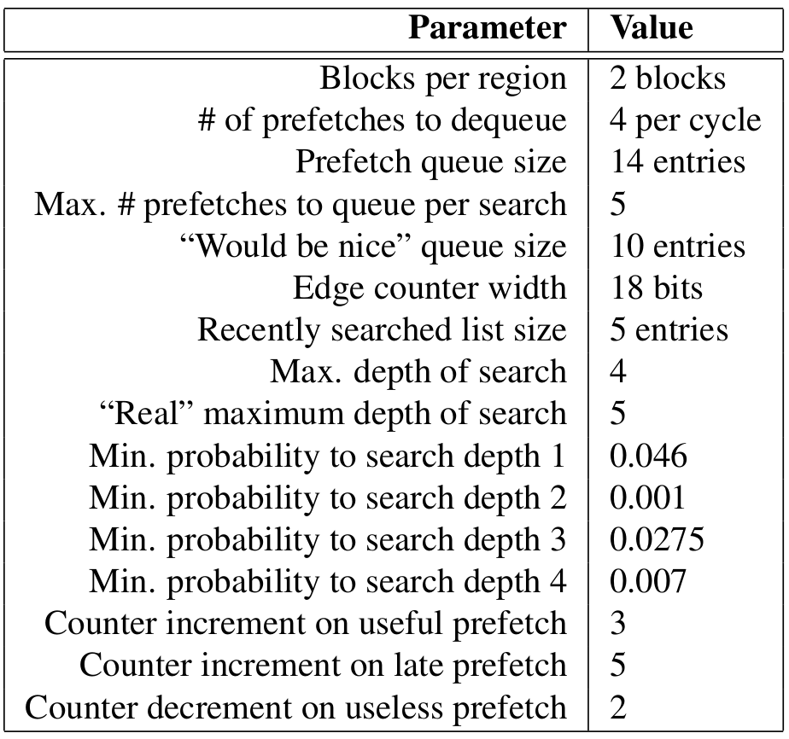
Parameter Tuning

Slide 8
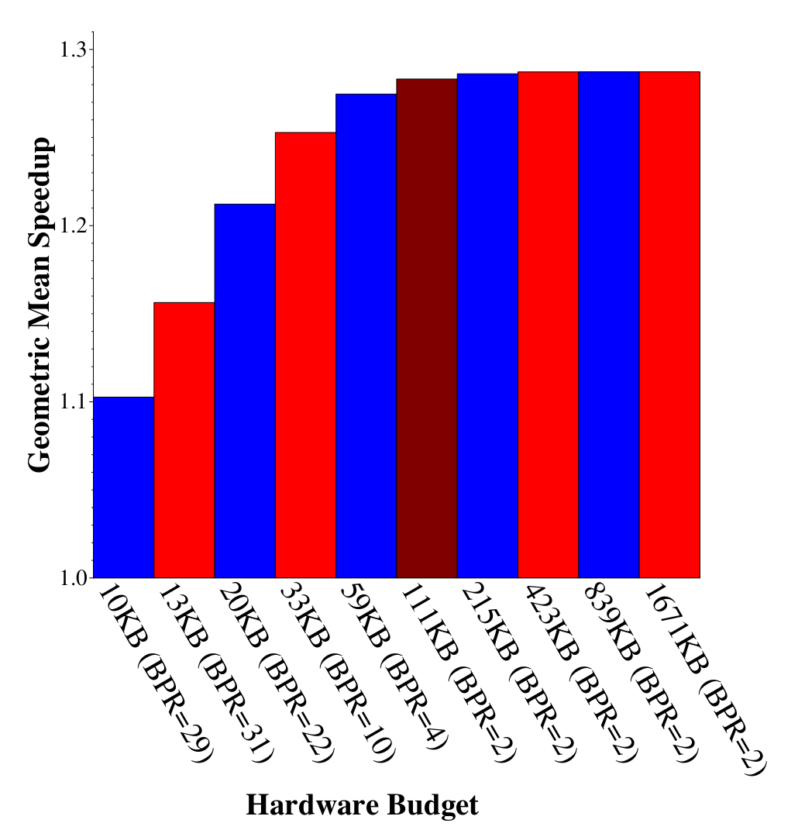
Scalability
A huge h/w budget doesn’t really show the potential of multi-block regions in reducing CFG metadata. Gets 28.3% speedup with 111KB, 2 block regions
Barça does well at lower budgets
E.g. 25% speedup at 33KB, with 10 block regions

Slide 9
Related Work
It’s a lot like BTB-directed prefetchers [Smith & Hsu 1992, Kaynak et al. 2015, Kumar et al. 2017,2018, etc.]
It’s a lot like a Markov prefetcher [Joseph & Grunwald 1999]
Uses spatial patterns [Kumar & Wilkerson, 1998, Somyagi et al. 2009]
Address compression from ITTAGE [Seznec 2011]
Funny set-associative BTB matching multiple targets [Garza et al. 2019]

Slide 10
Future Work
Barça is one technique. It does well by itself
It would do better hybridized with other techniques
I dislike this approach because I cling to old-school notions of “elegance”
Also, industry doesn’t like your hybrid designs. They get in the way of clarity
But elegance doesn’t win optimization championships
If I am unable to resist competing in the next championship like a moth to a flame I’ll have to capitulate to hybridization

